Slide 1
Presented By: Aaron Scott
Mentor: Ezra McNichols
Date: 05/28/2020

Slide 2
PRIMARY PROJECTS
PHP Testing: Pulsating Heat Pipe Testing
PMC Testing: Polymer Matrix Composite Testing
LWHP Modeling: Lattice Wick Heat Pipe Modeling

Slide 3

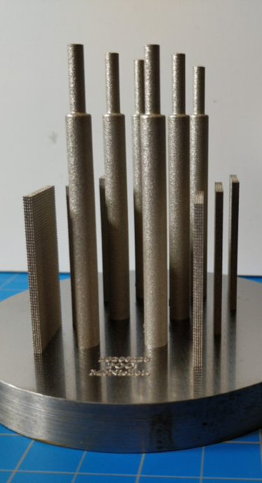
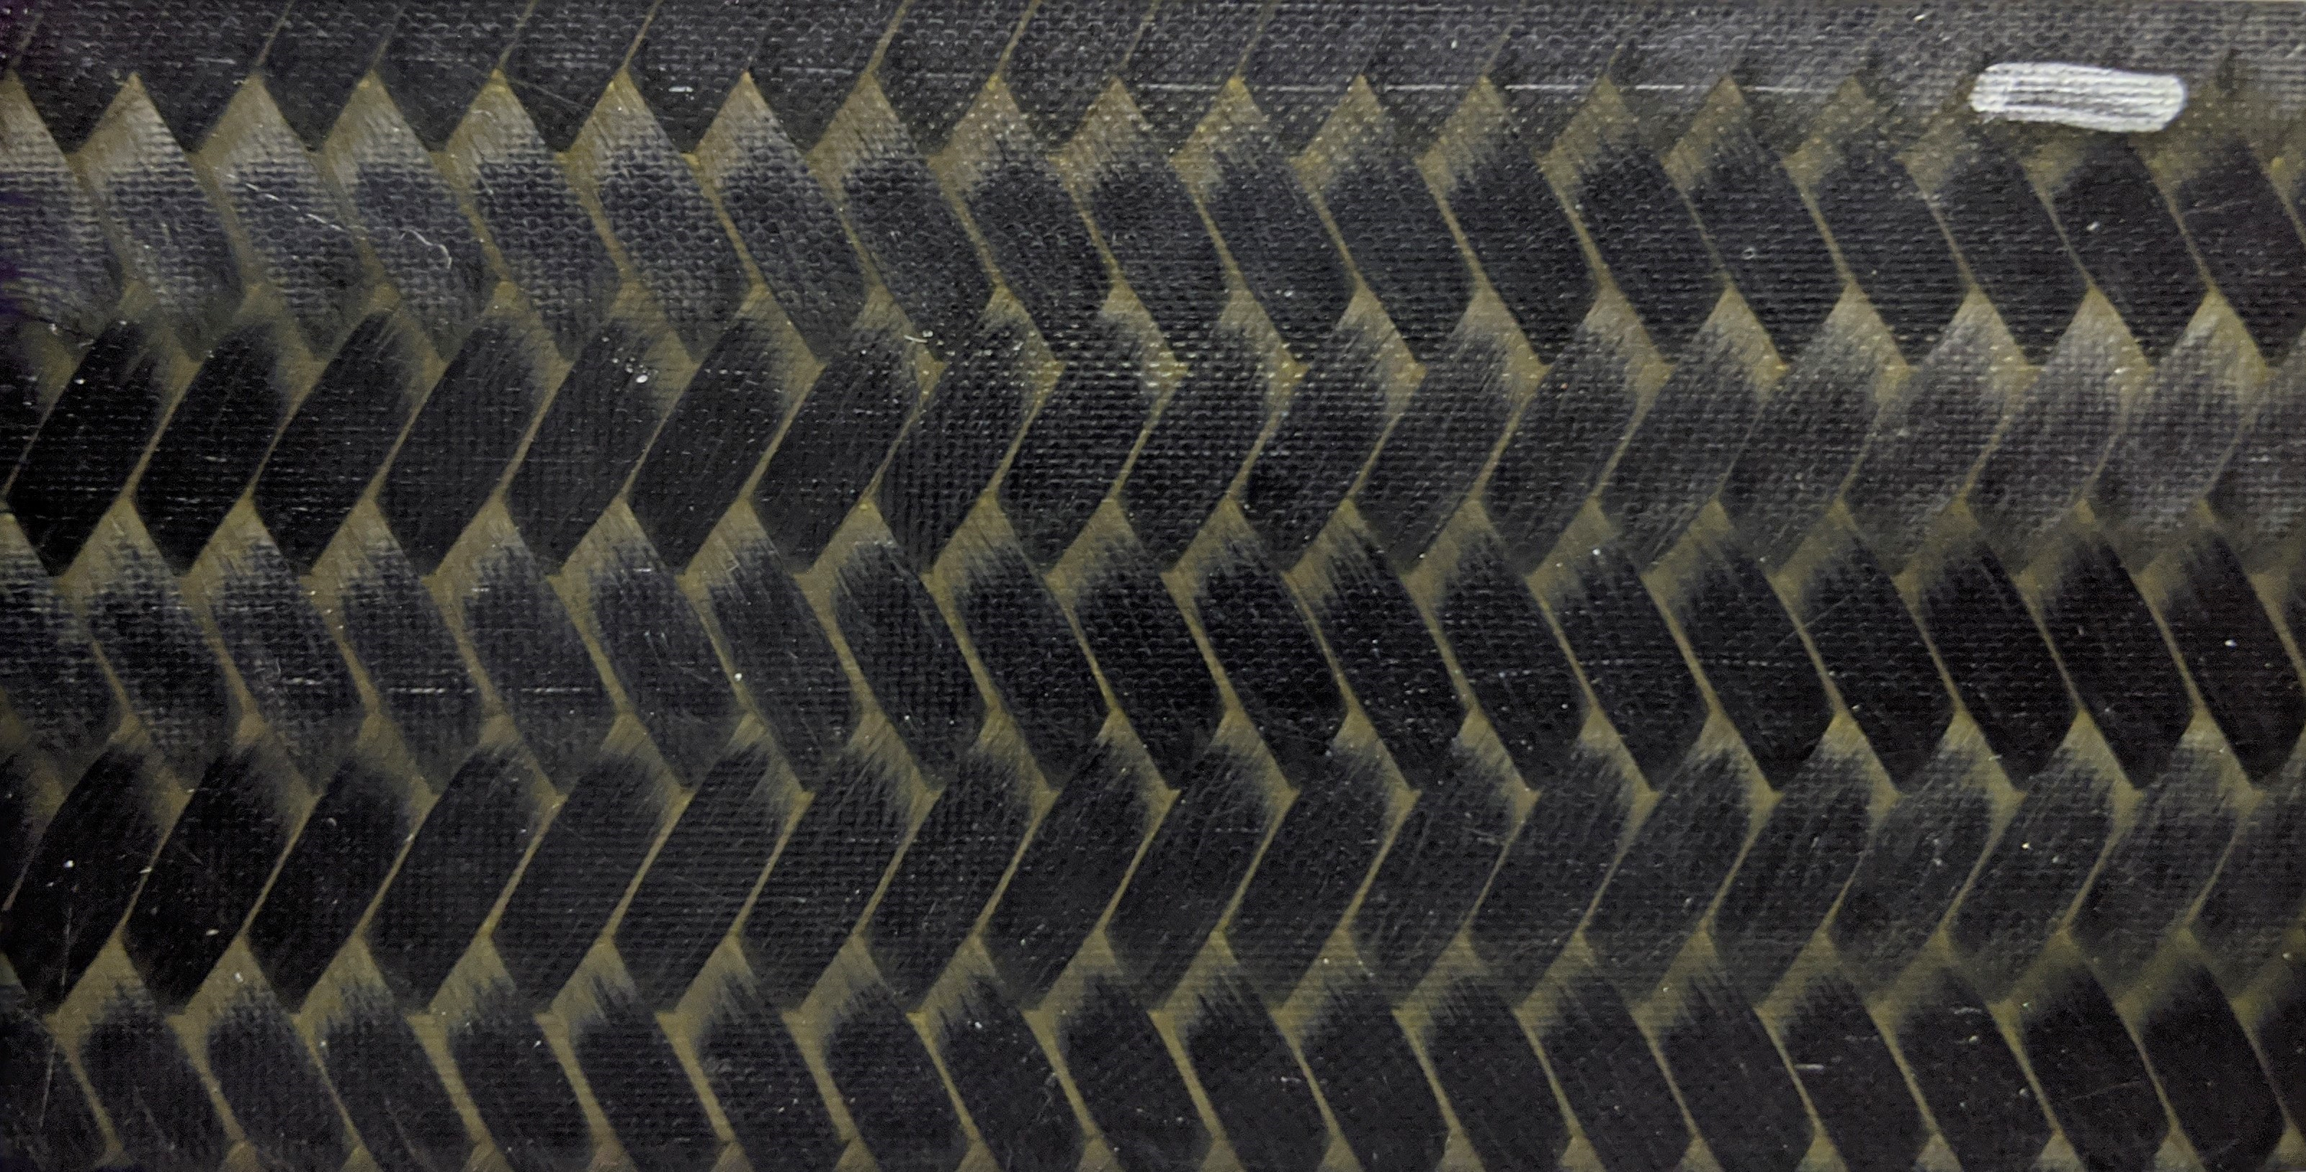
THE TEST ARTICLES
PHP Pulsating Heat Pipes
PMC Polymer Matrix Composites
LWHP Lattice Wick Heat Pipes

Slide 4
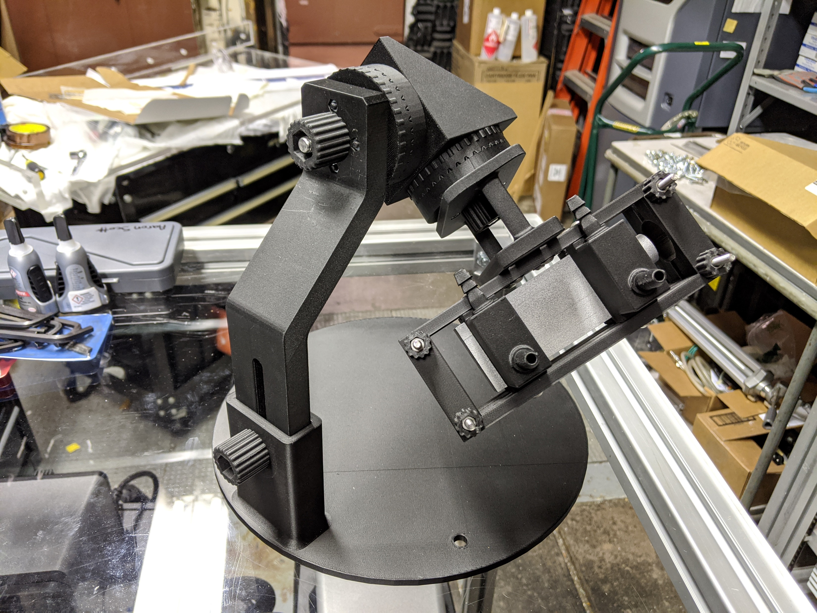
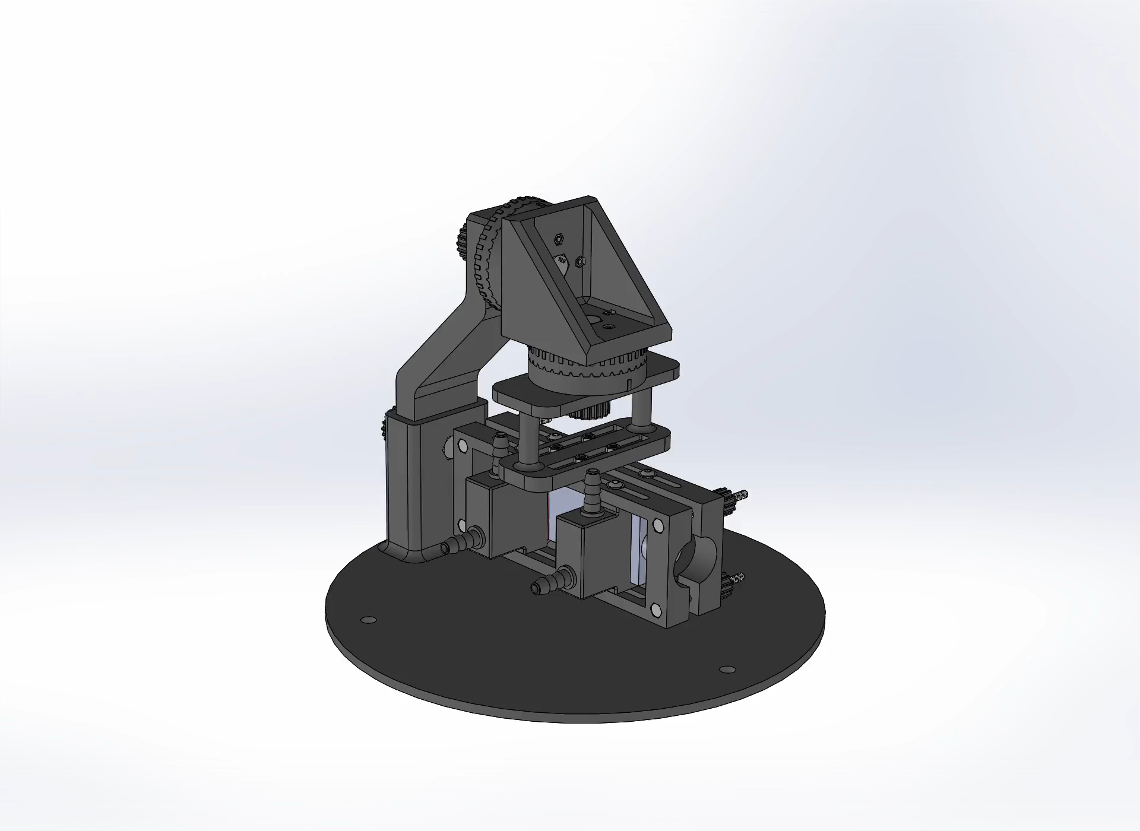
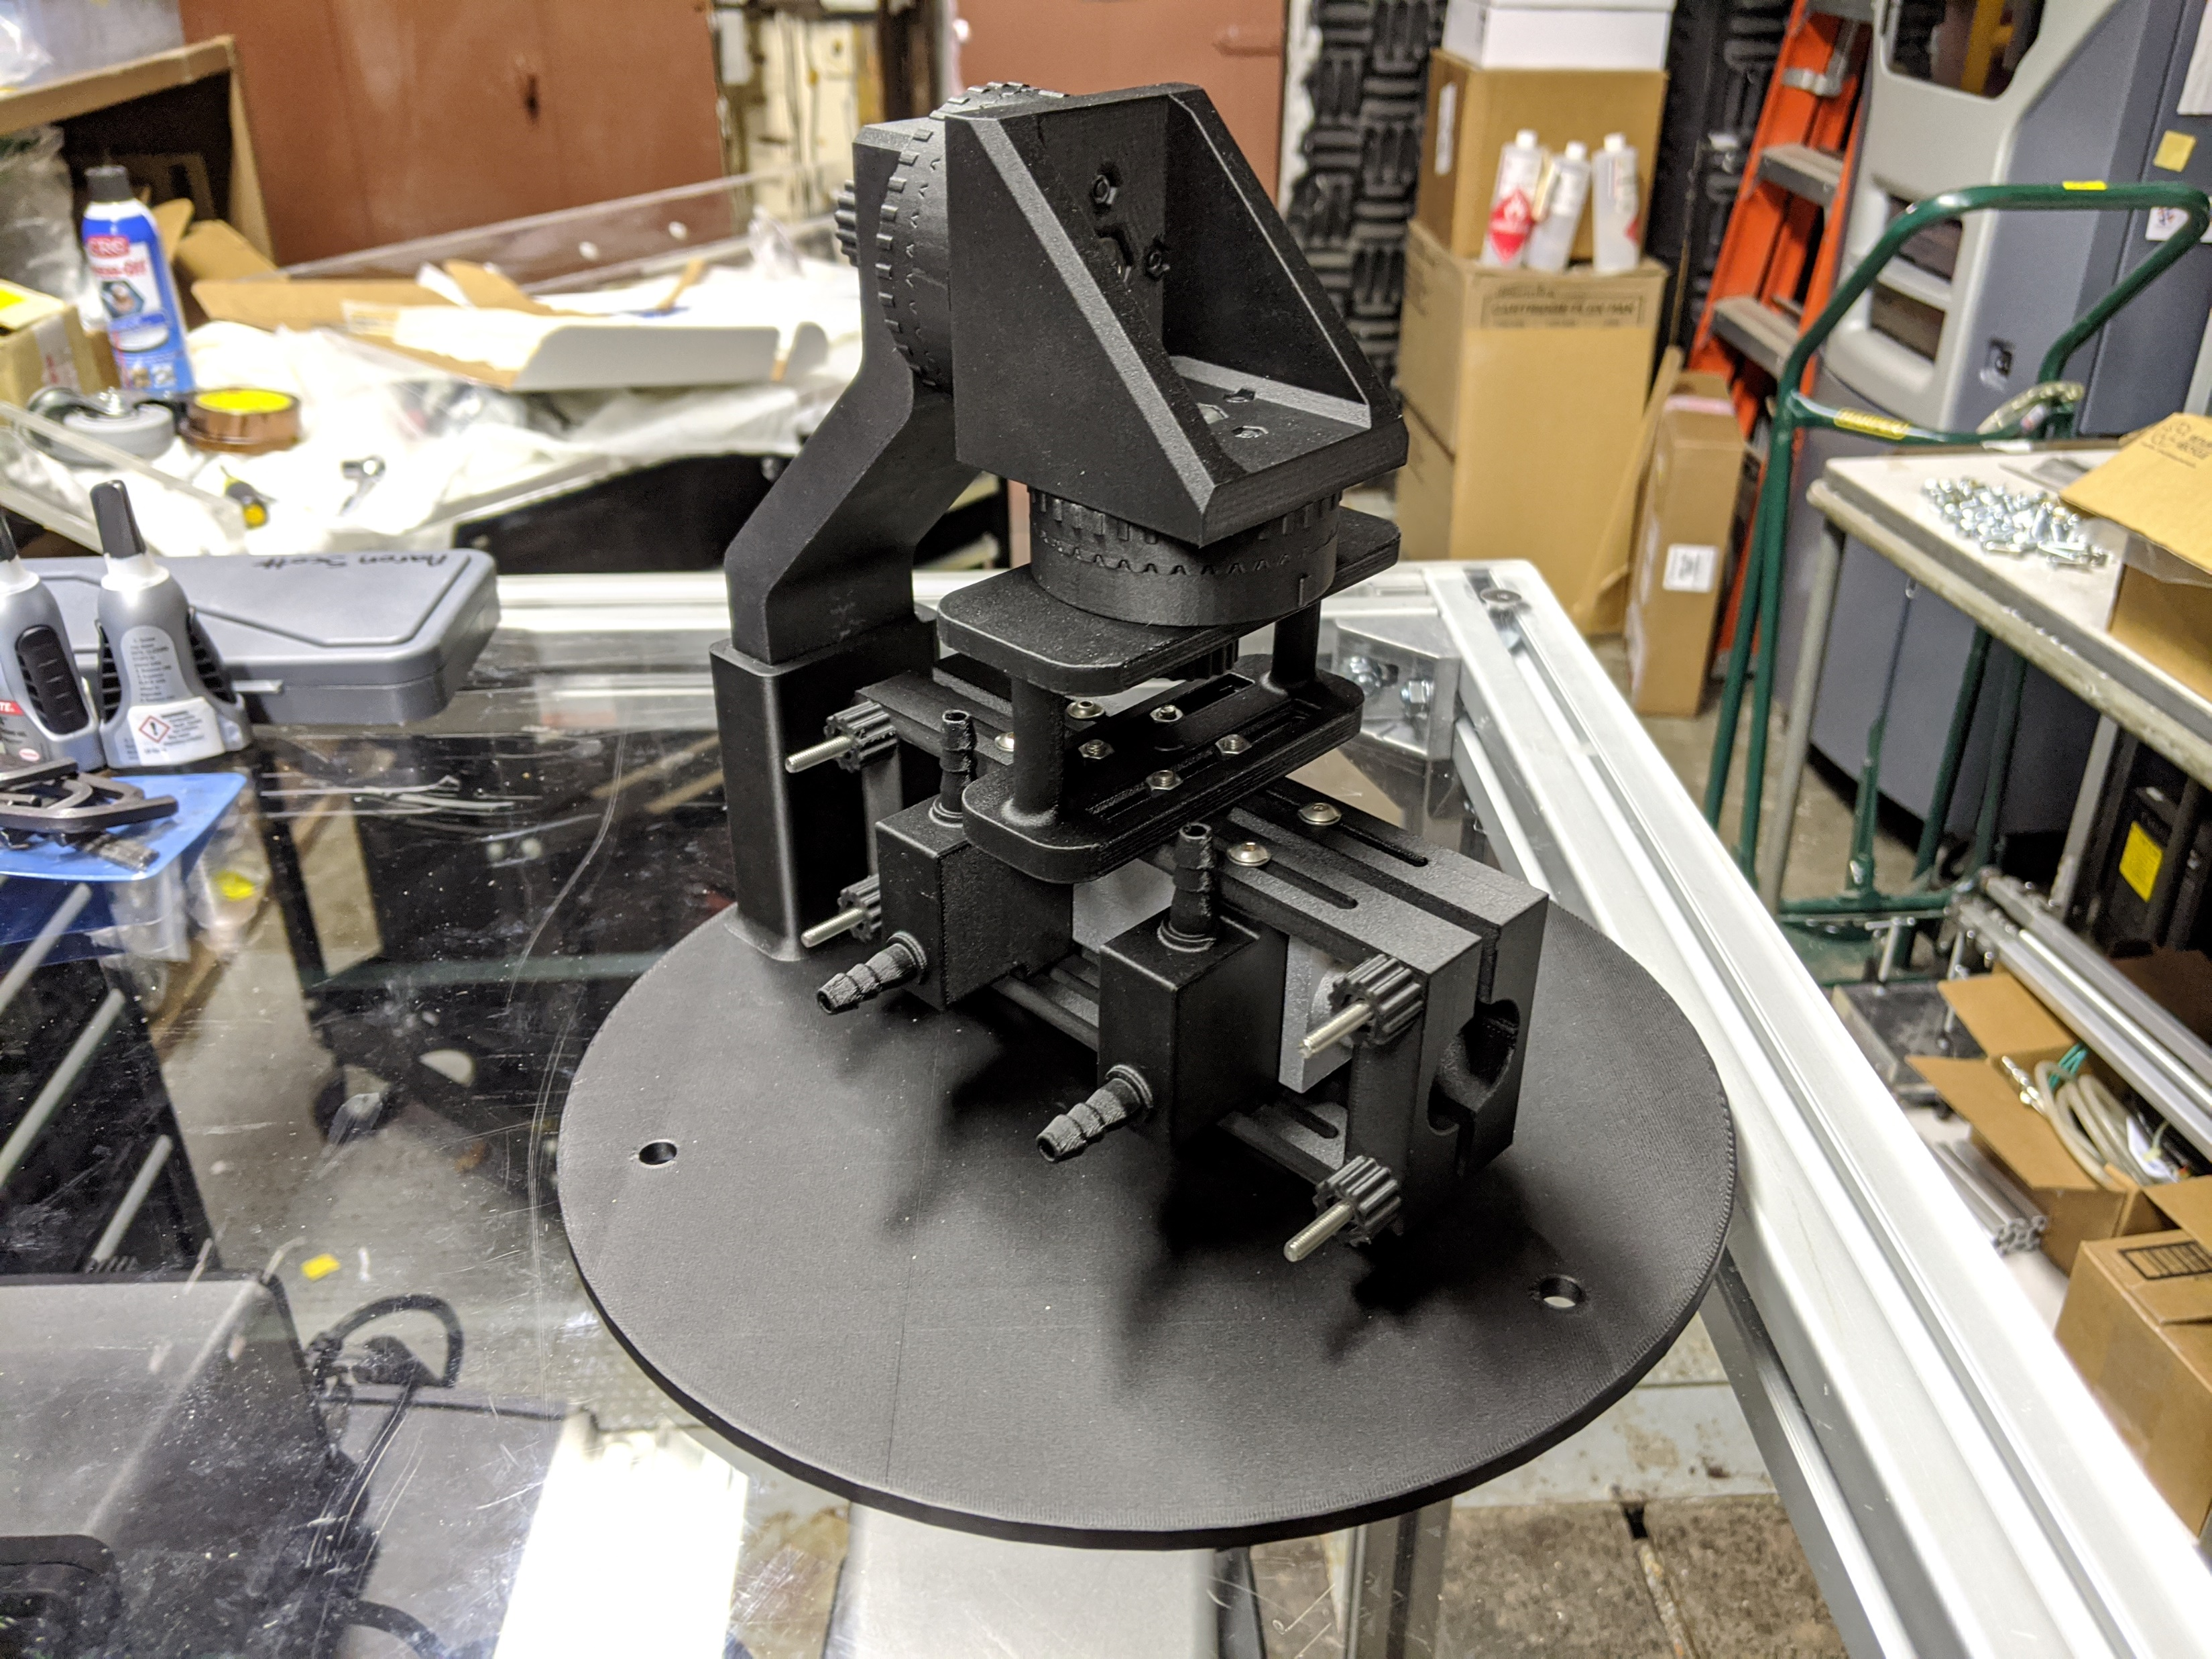
PHP: TESTING

Slide 5
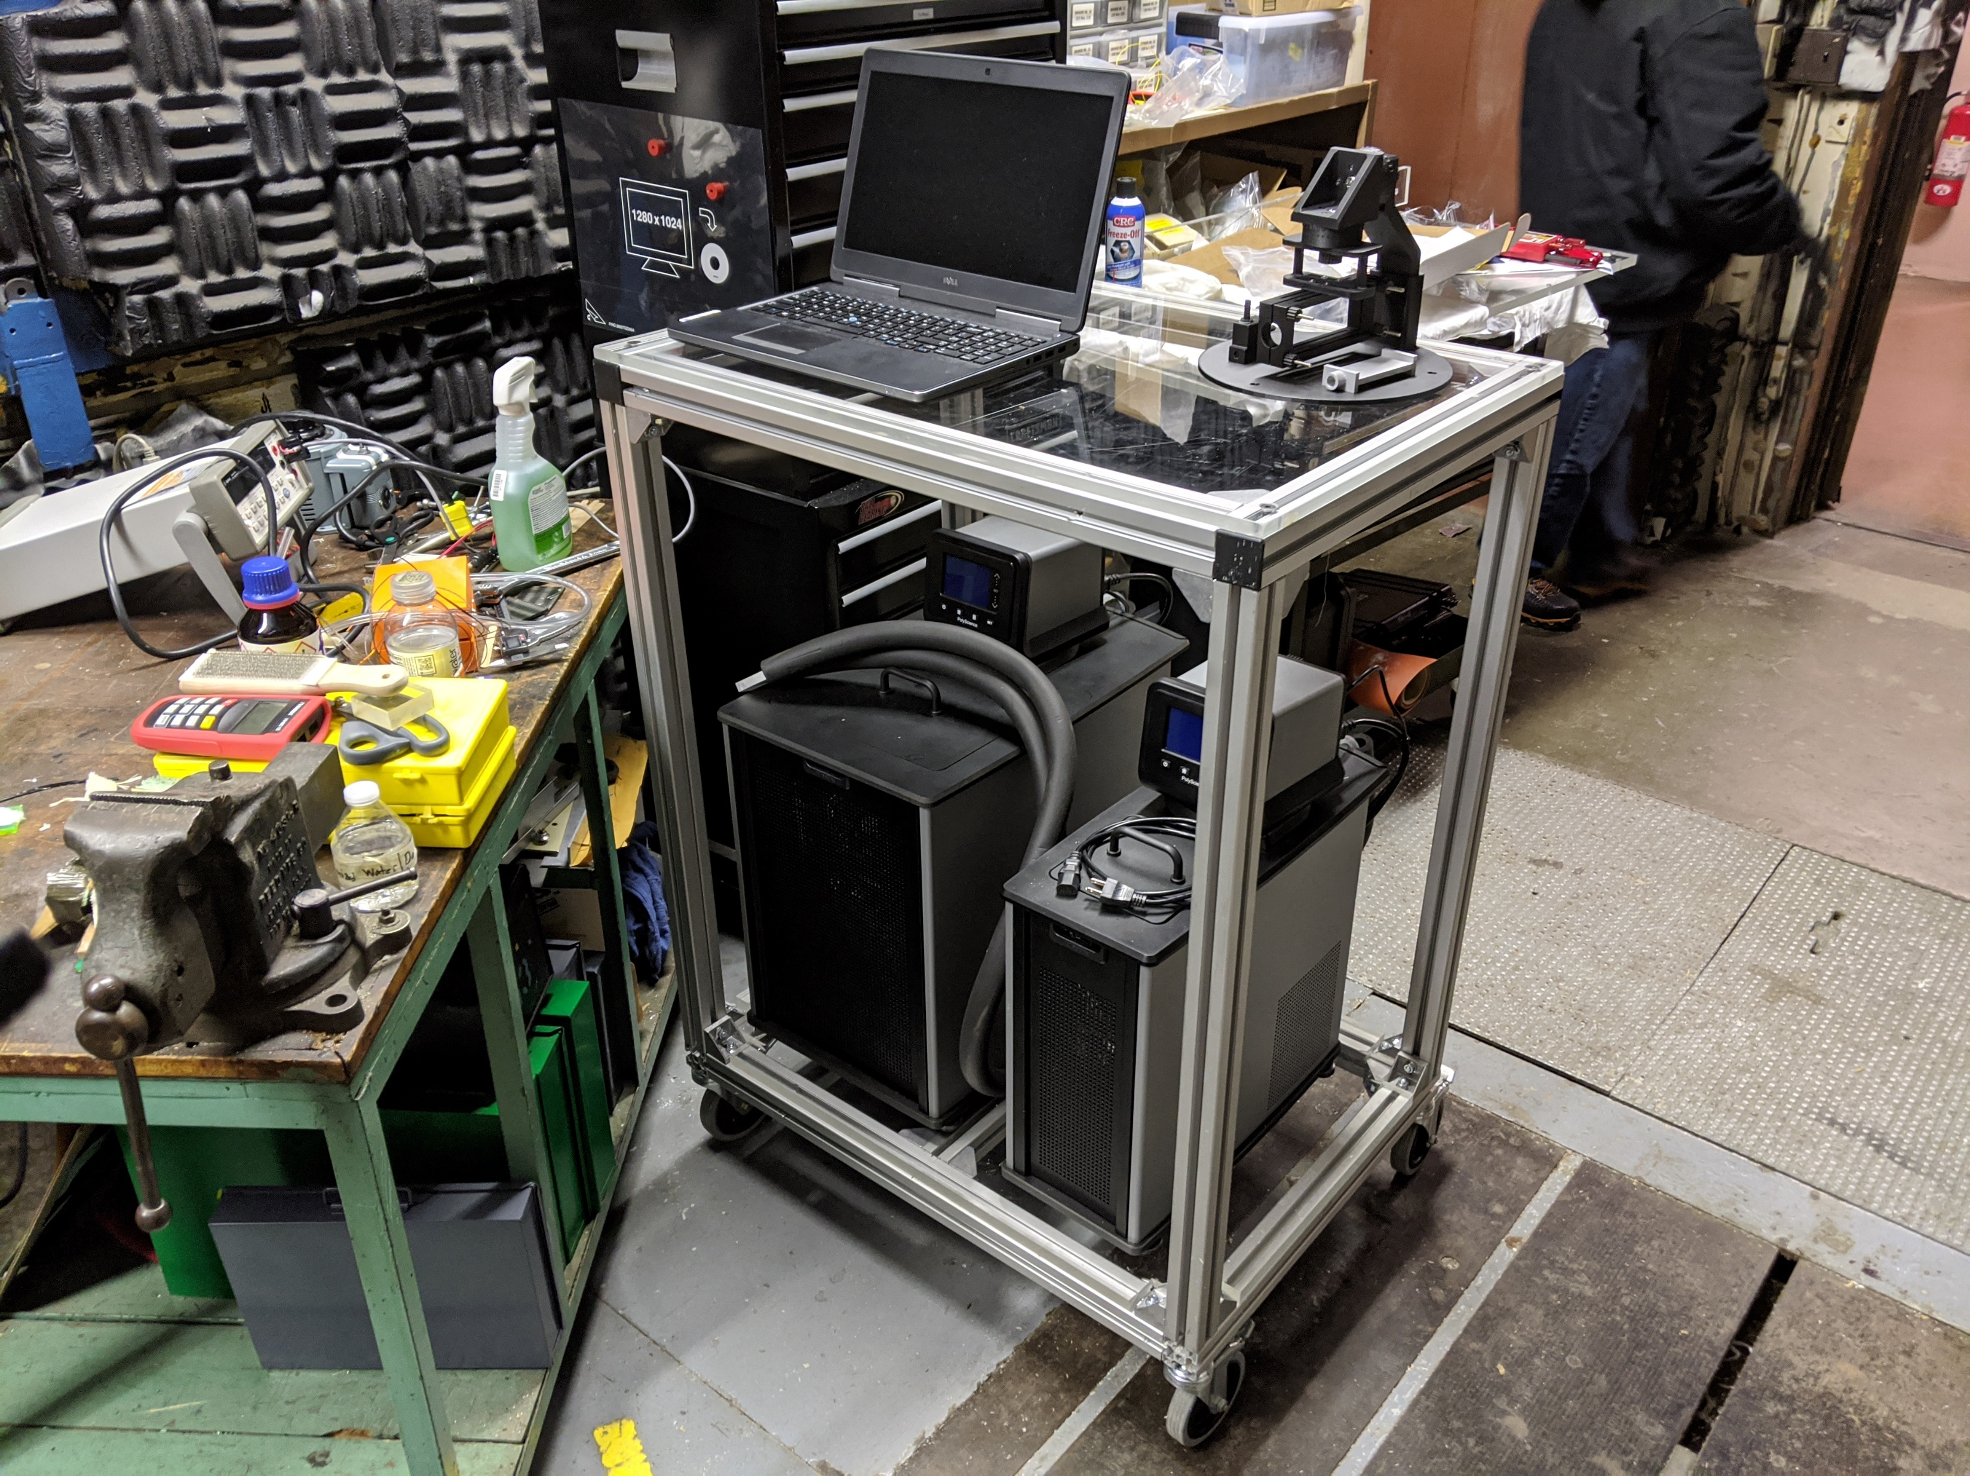
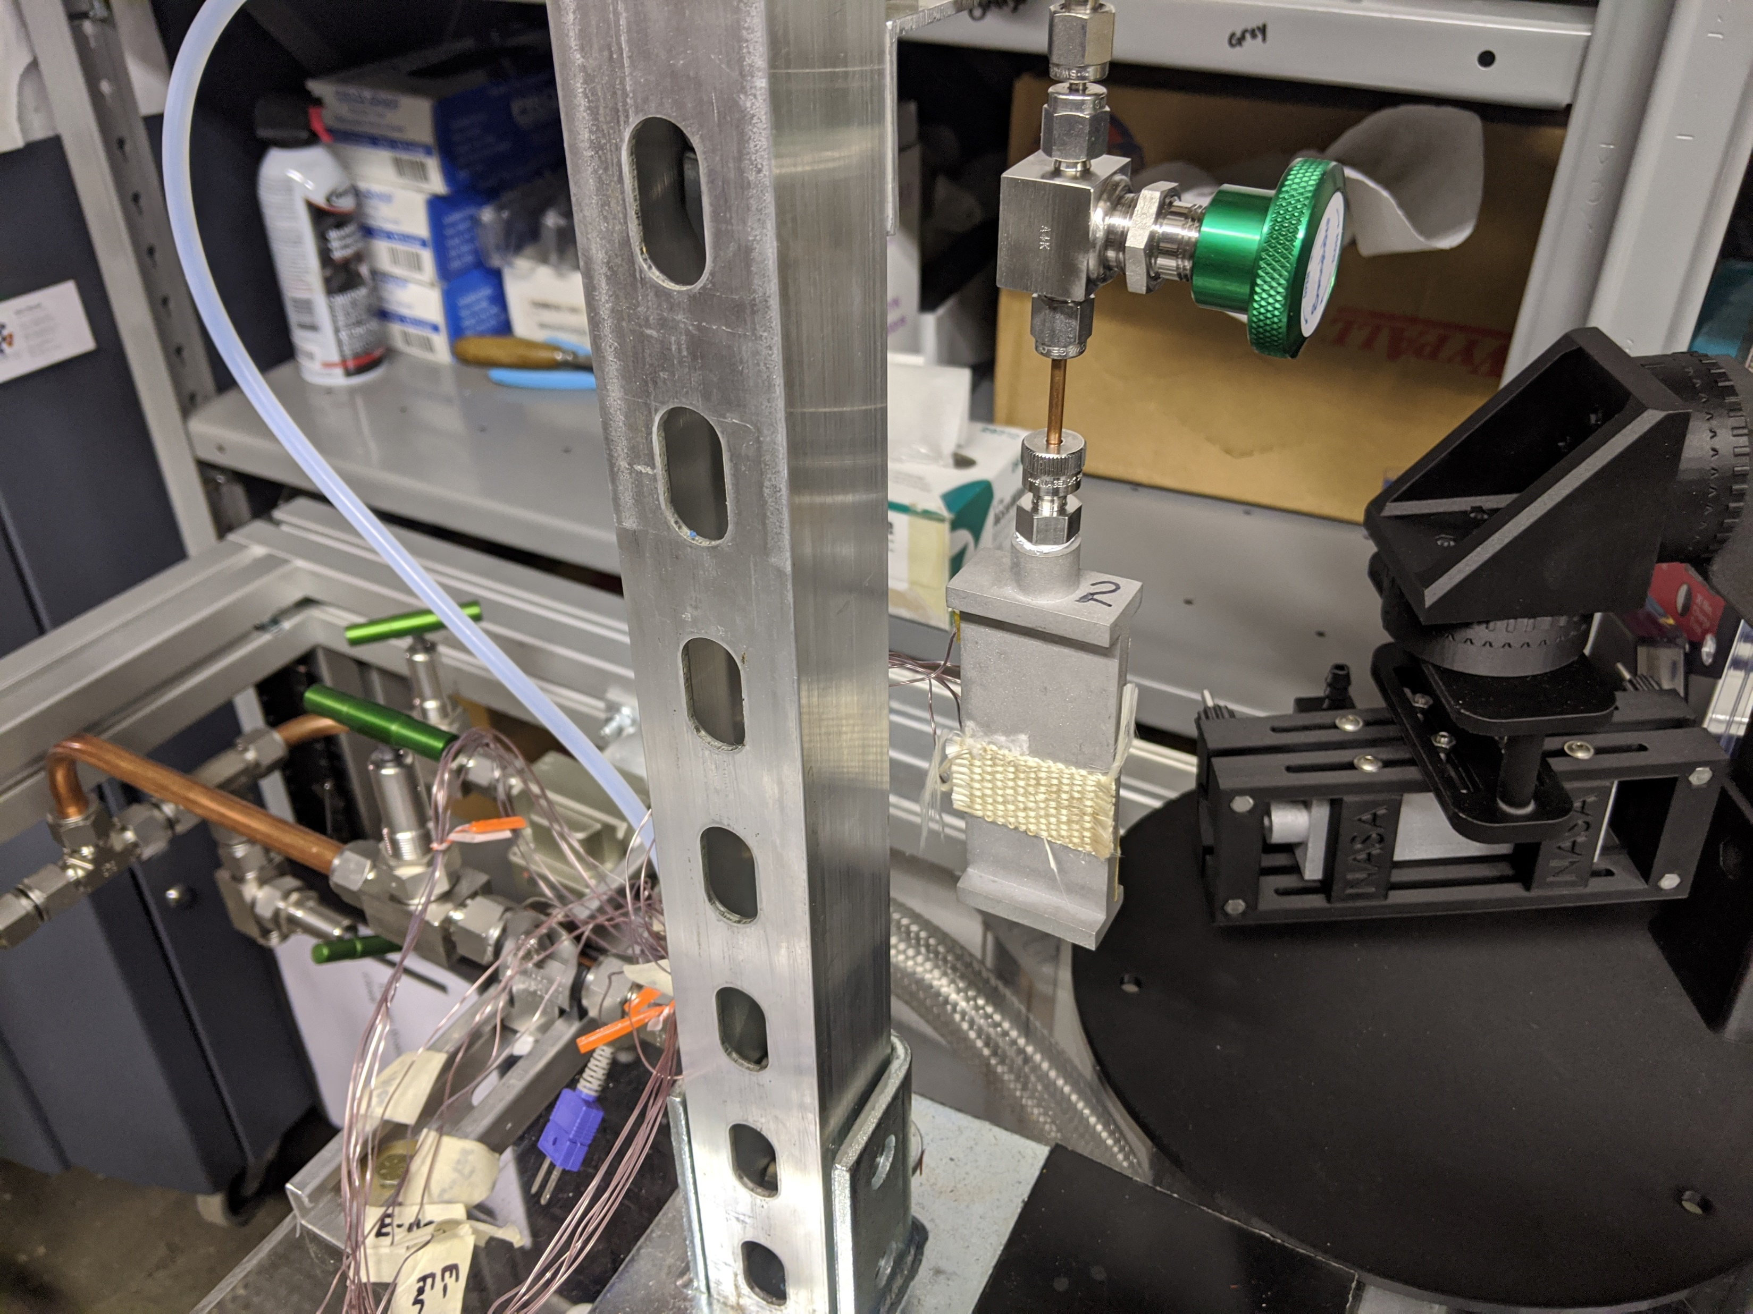
PHP: TESTING

Slide 6
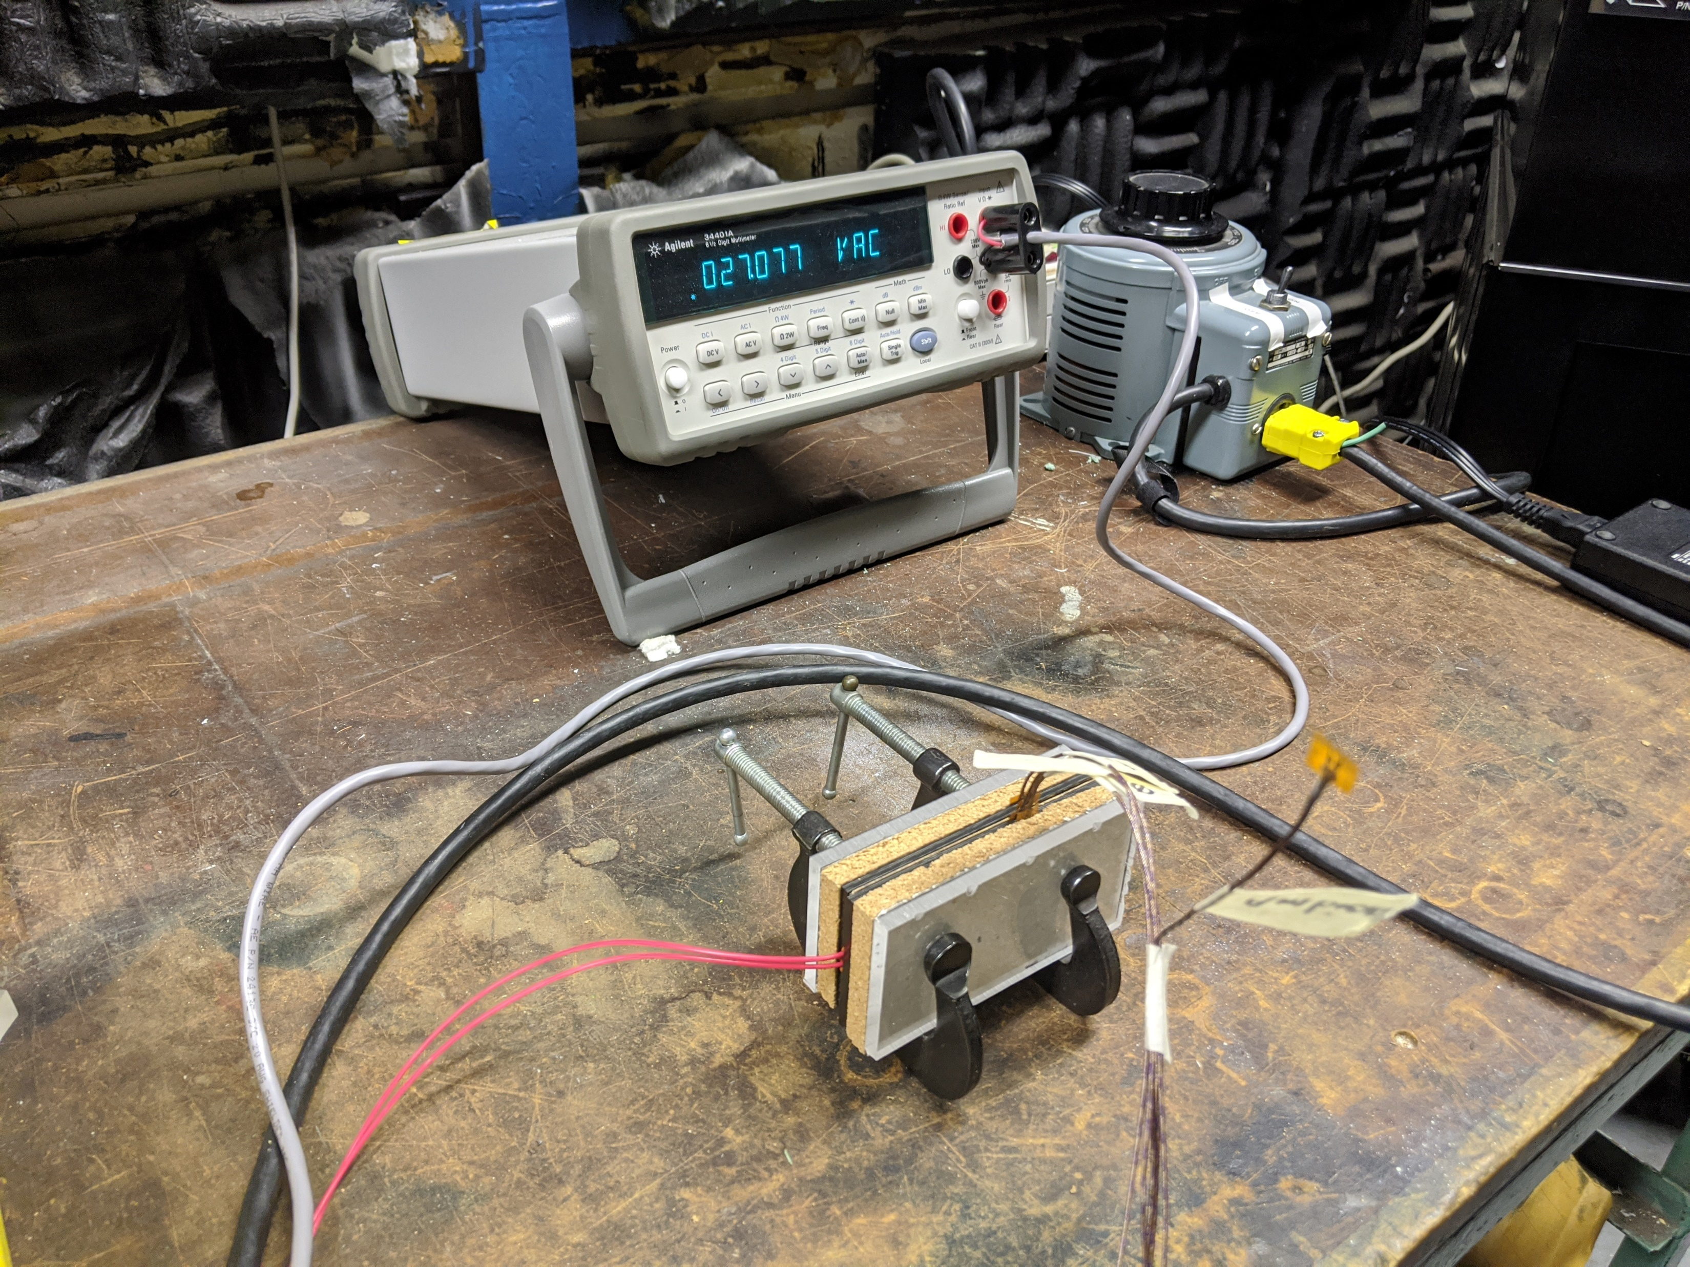
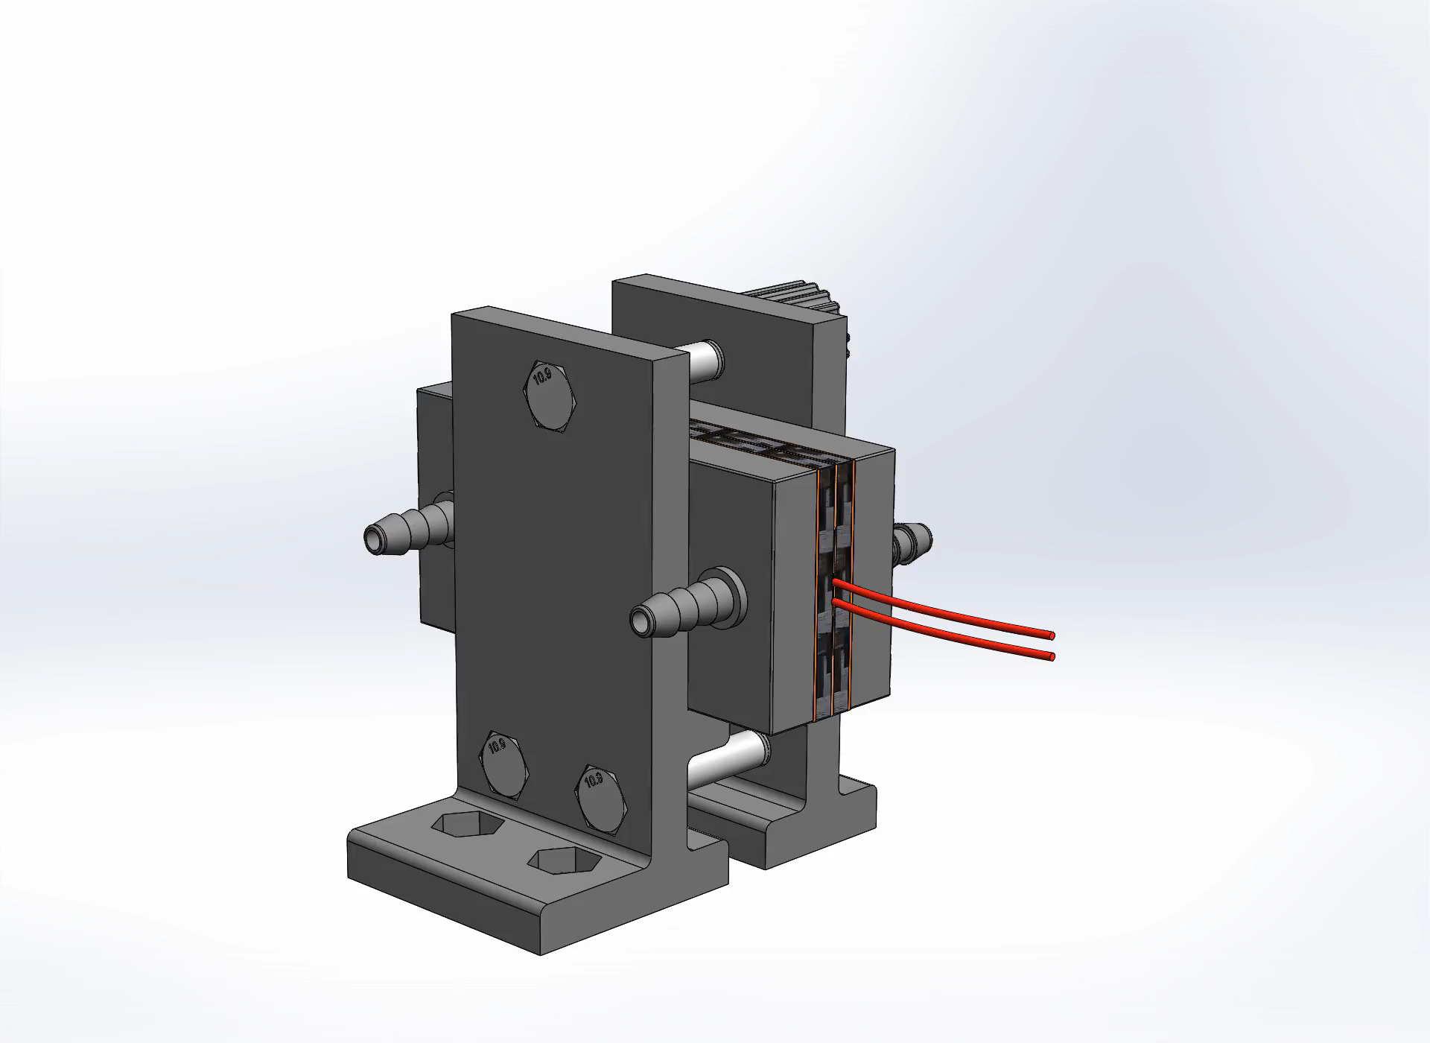
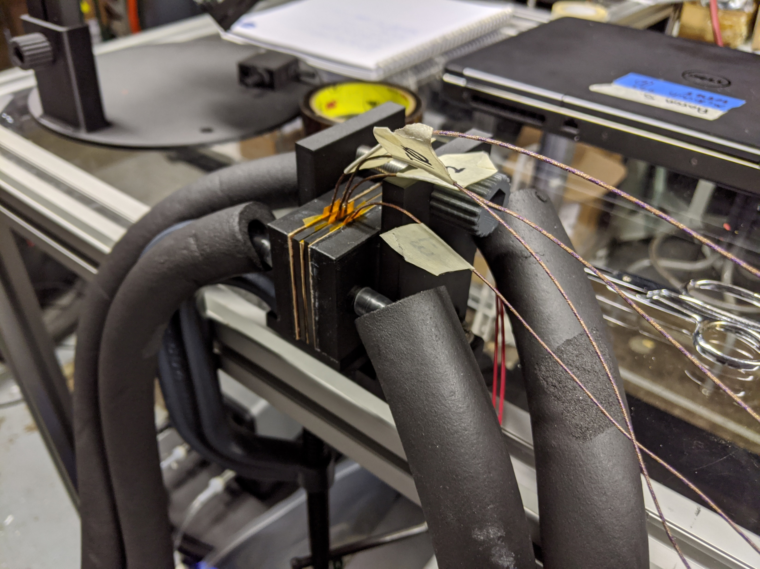
PMC: TESTING
TEST 1
TEST 2

Slide 7
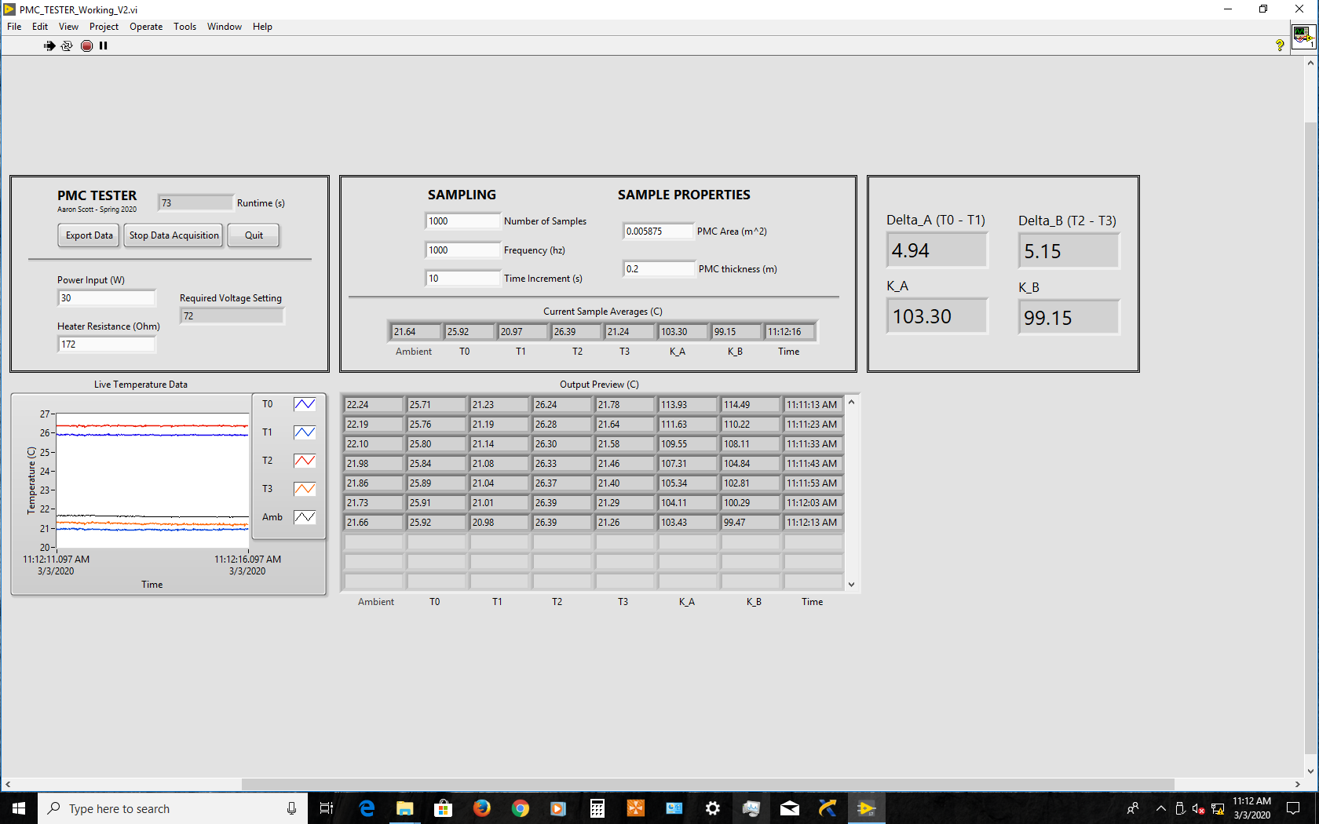
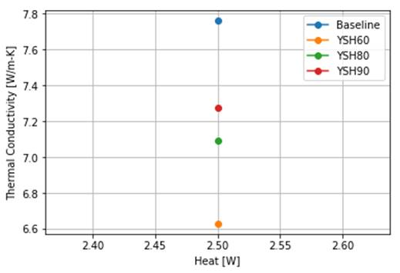
PMC: TESTING
TEST 1 RESULTS

Slide 8
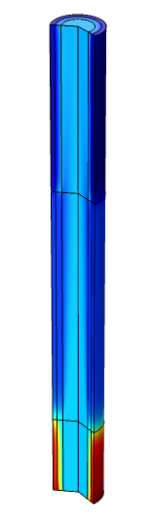
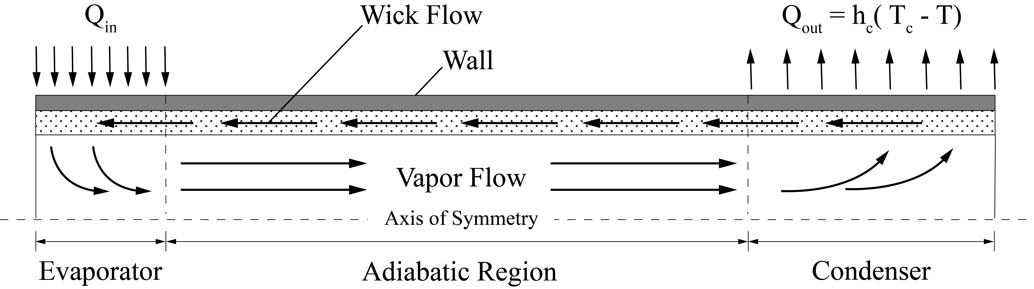
LWHP: GEOMETRY

Slide 9
LWHP: NUMERICAL MODEL
Heat Transfer in Solids and Fluids: Heat Conduction Transport Equations & Fourier’s law
Vapor Flow: Navier-Stokes Equations
Wick Flow: Darcy’s law

Slide 10
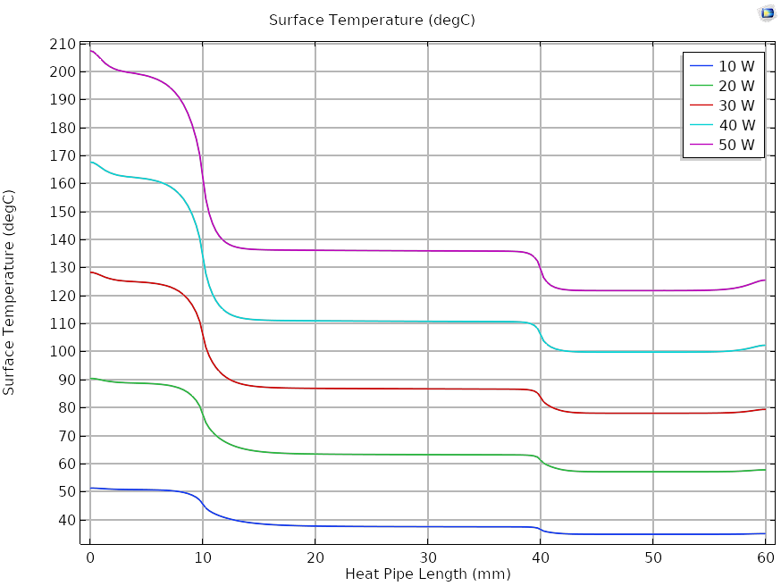
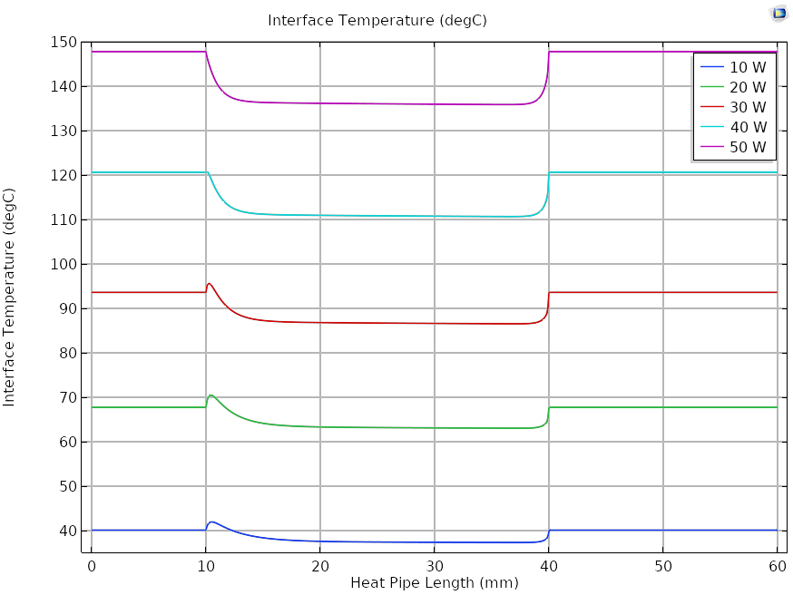
LWHP: RESULTS

Slide 11
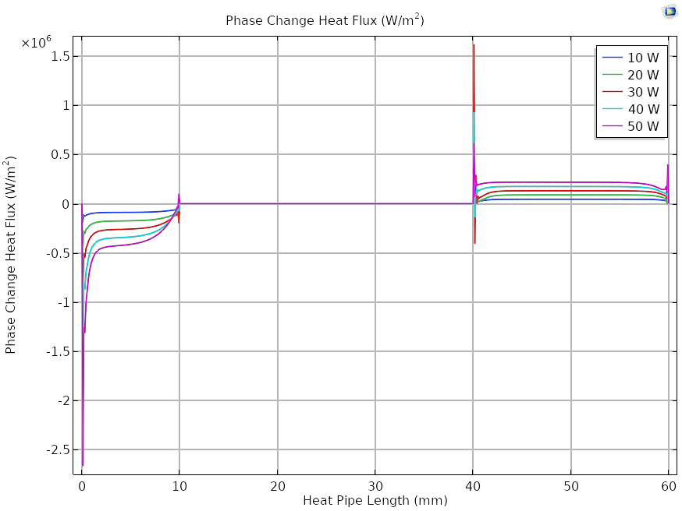
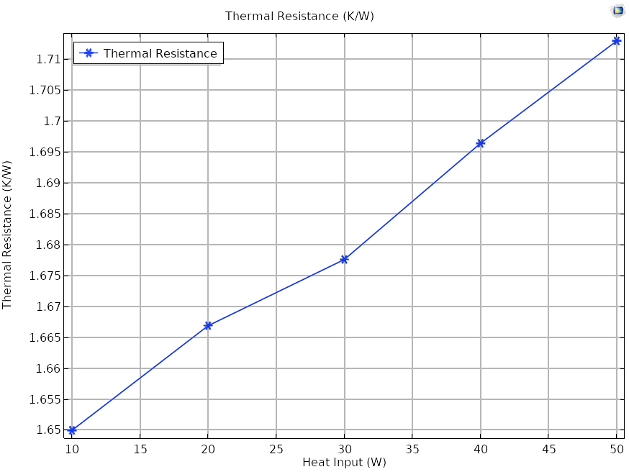
LWHP: RESULTS

Slide 12
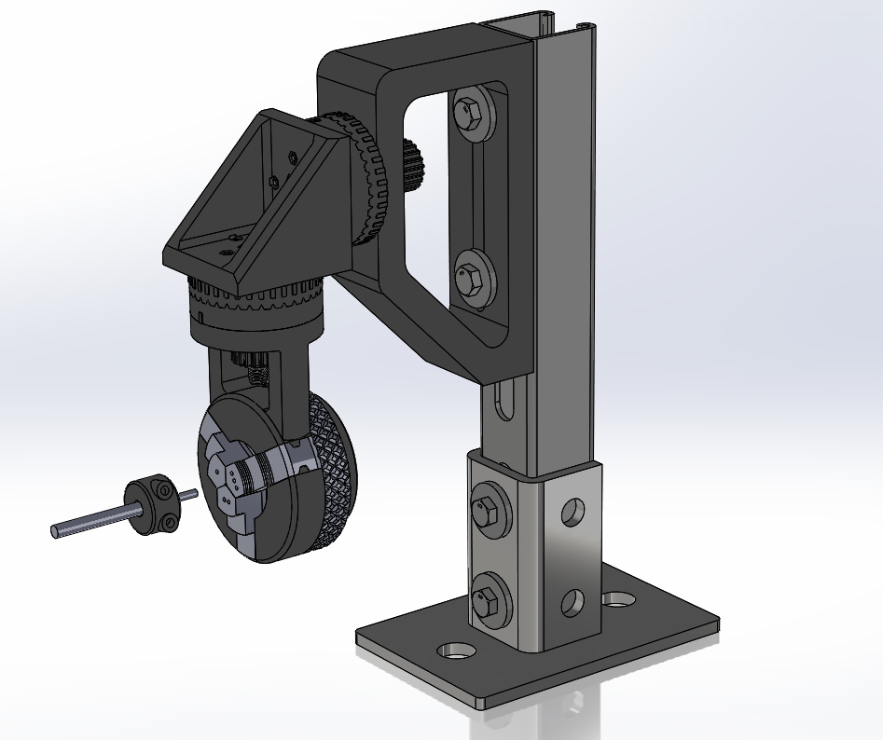
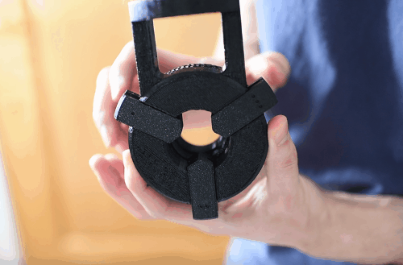
LWHP: FUTURE TESTING

Slide 13
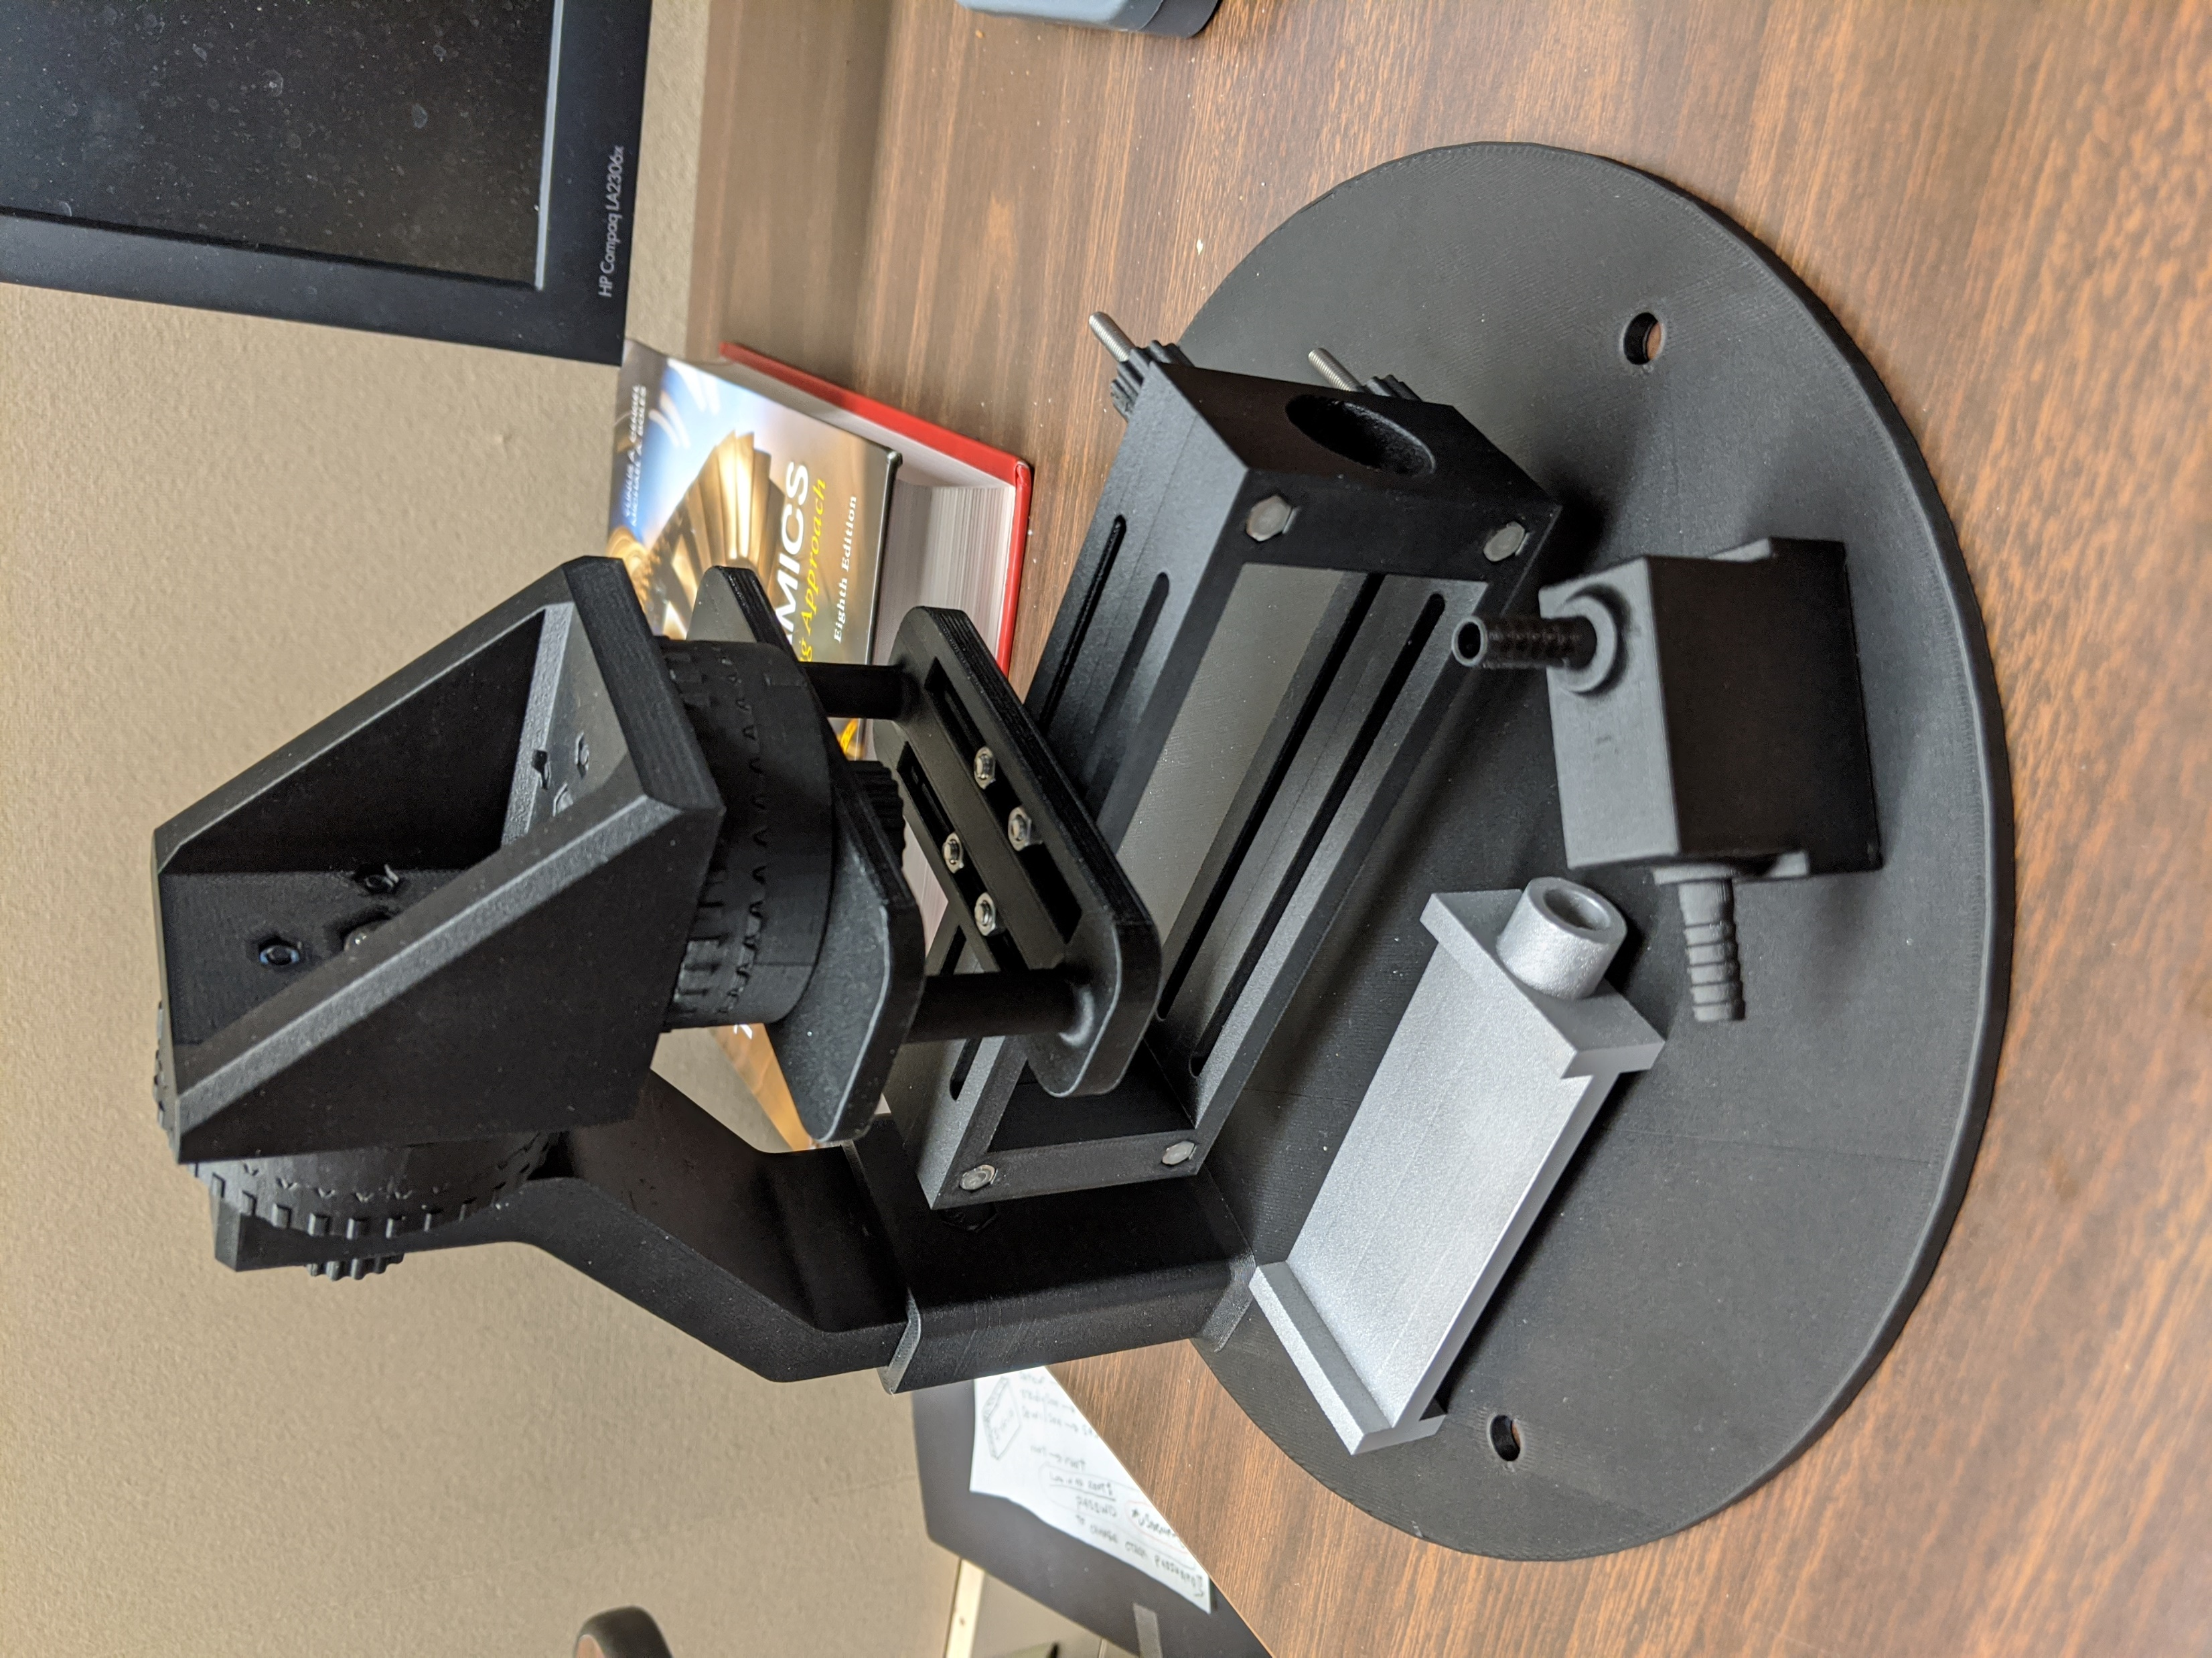
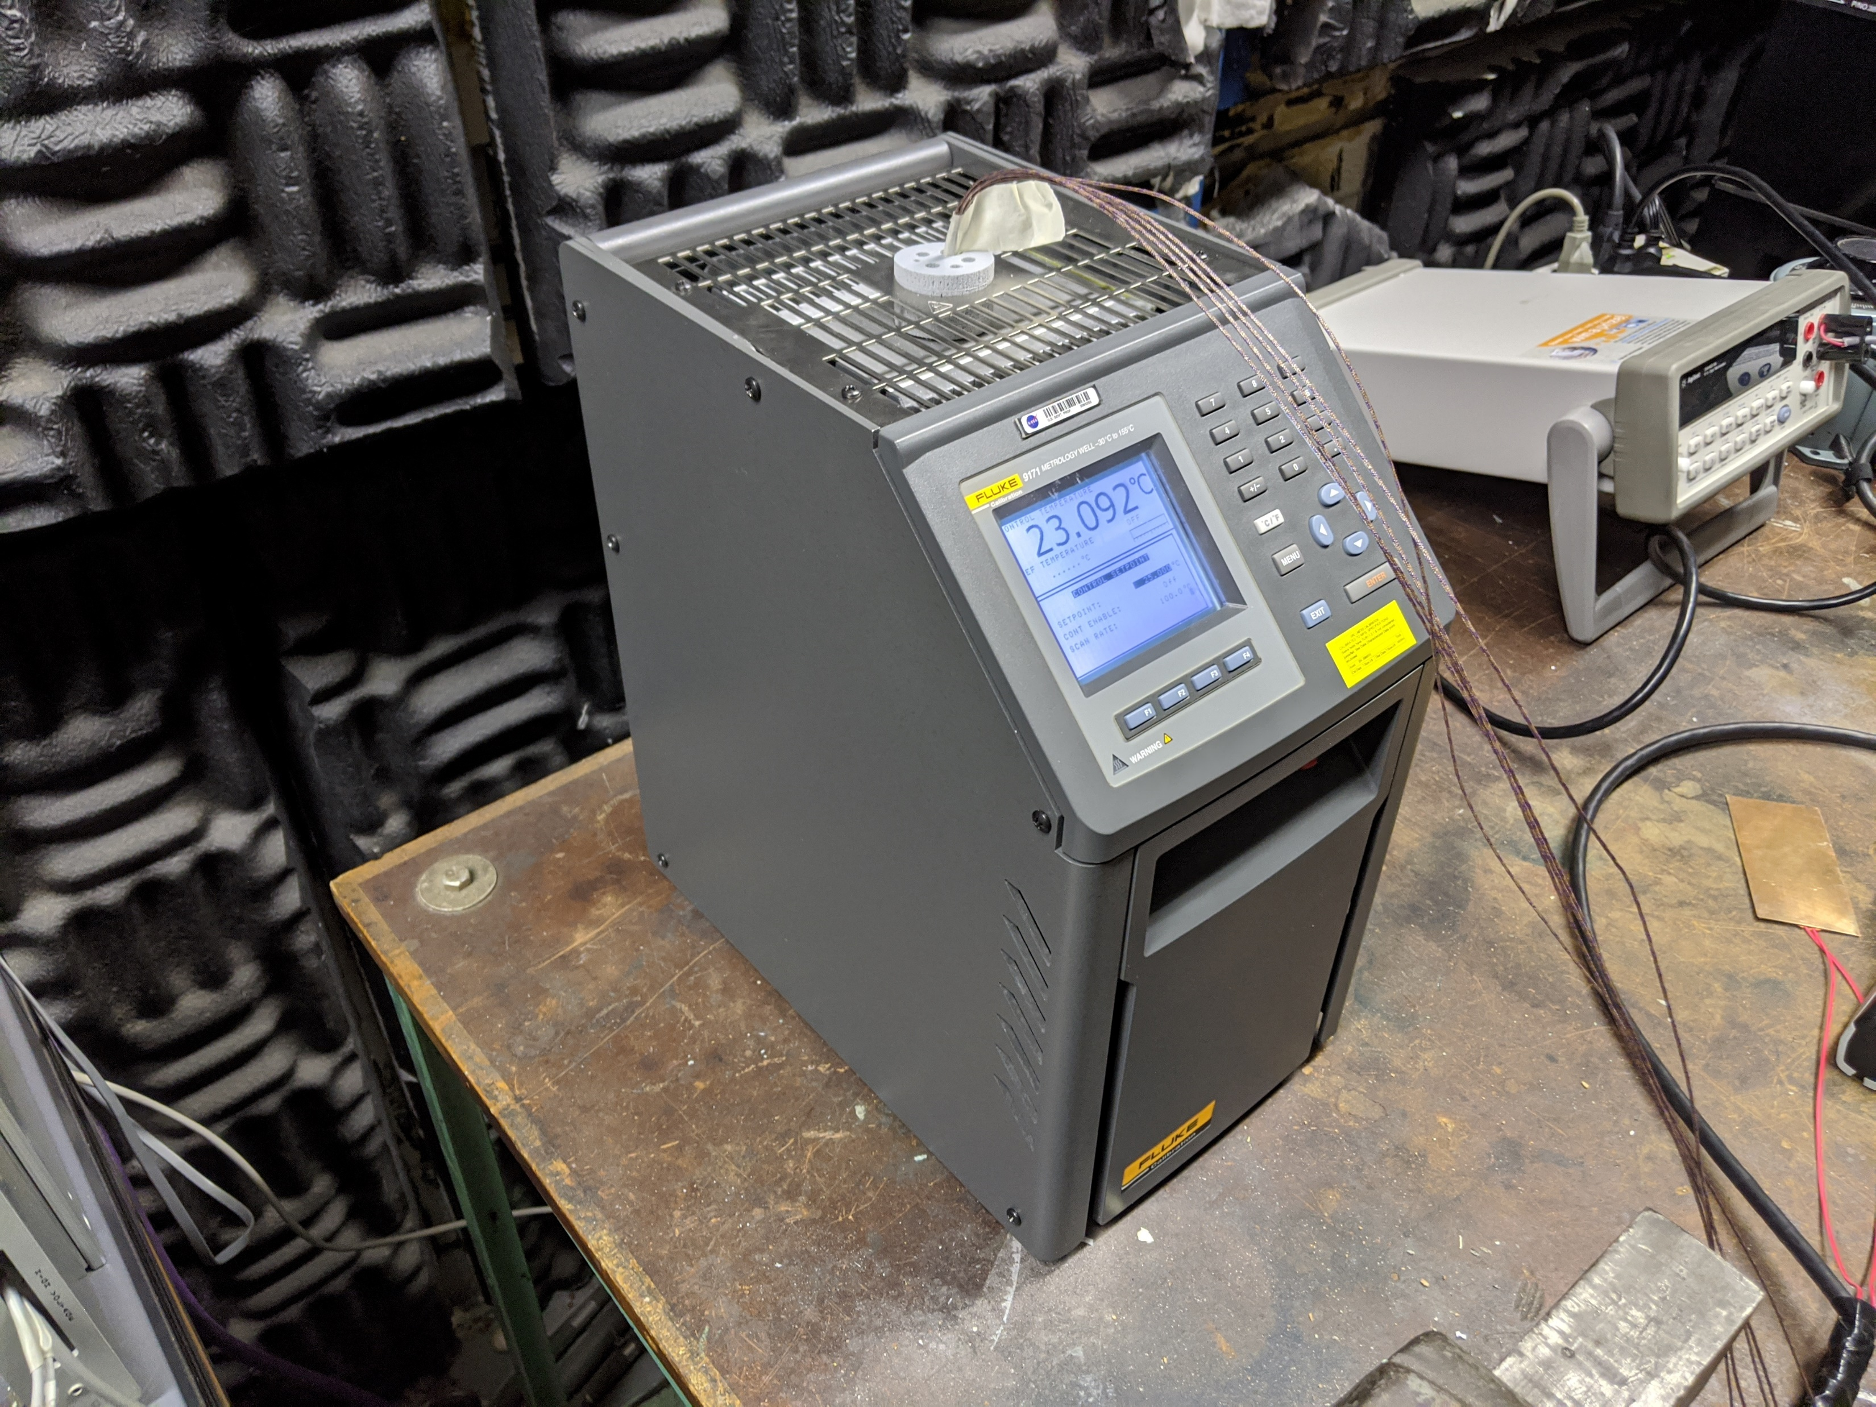
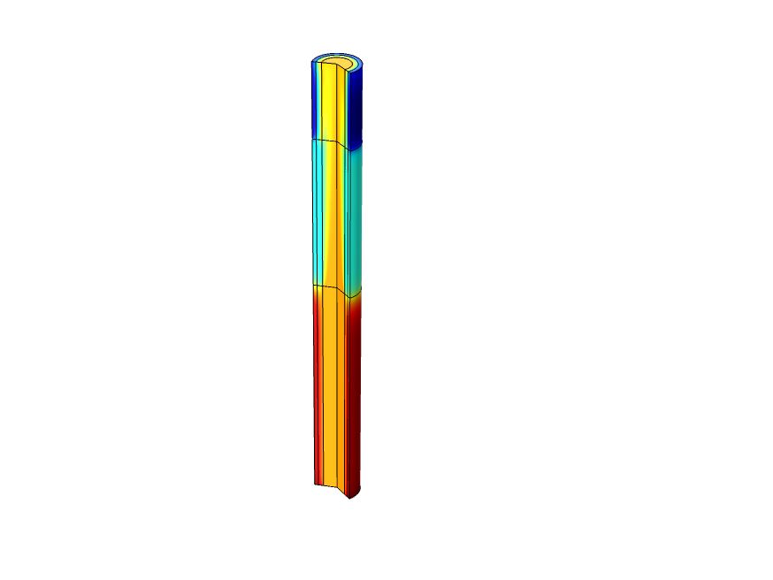
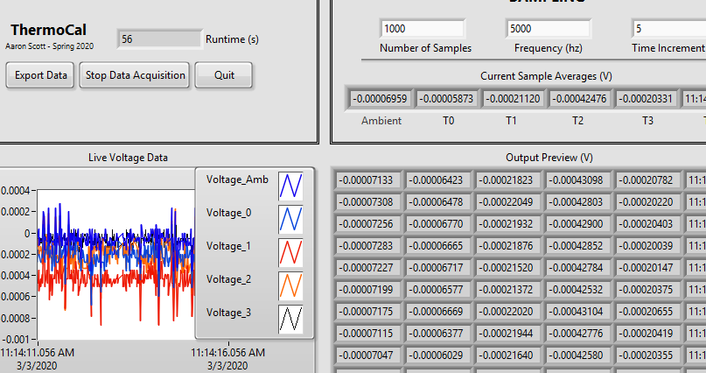
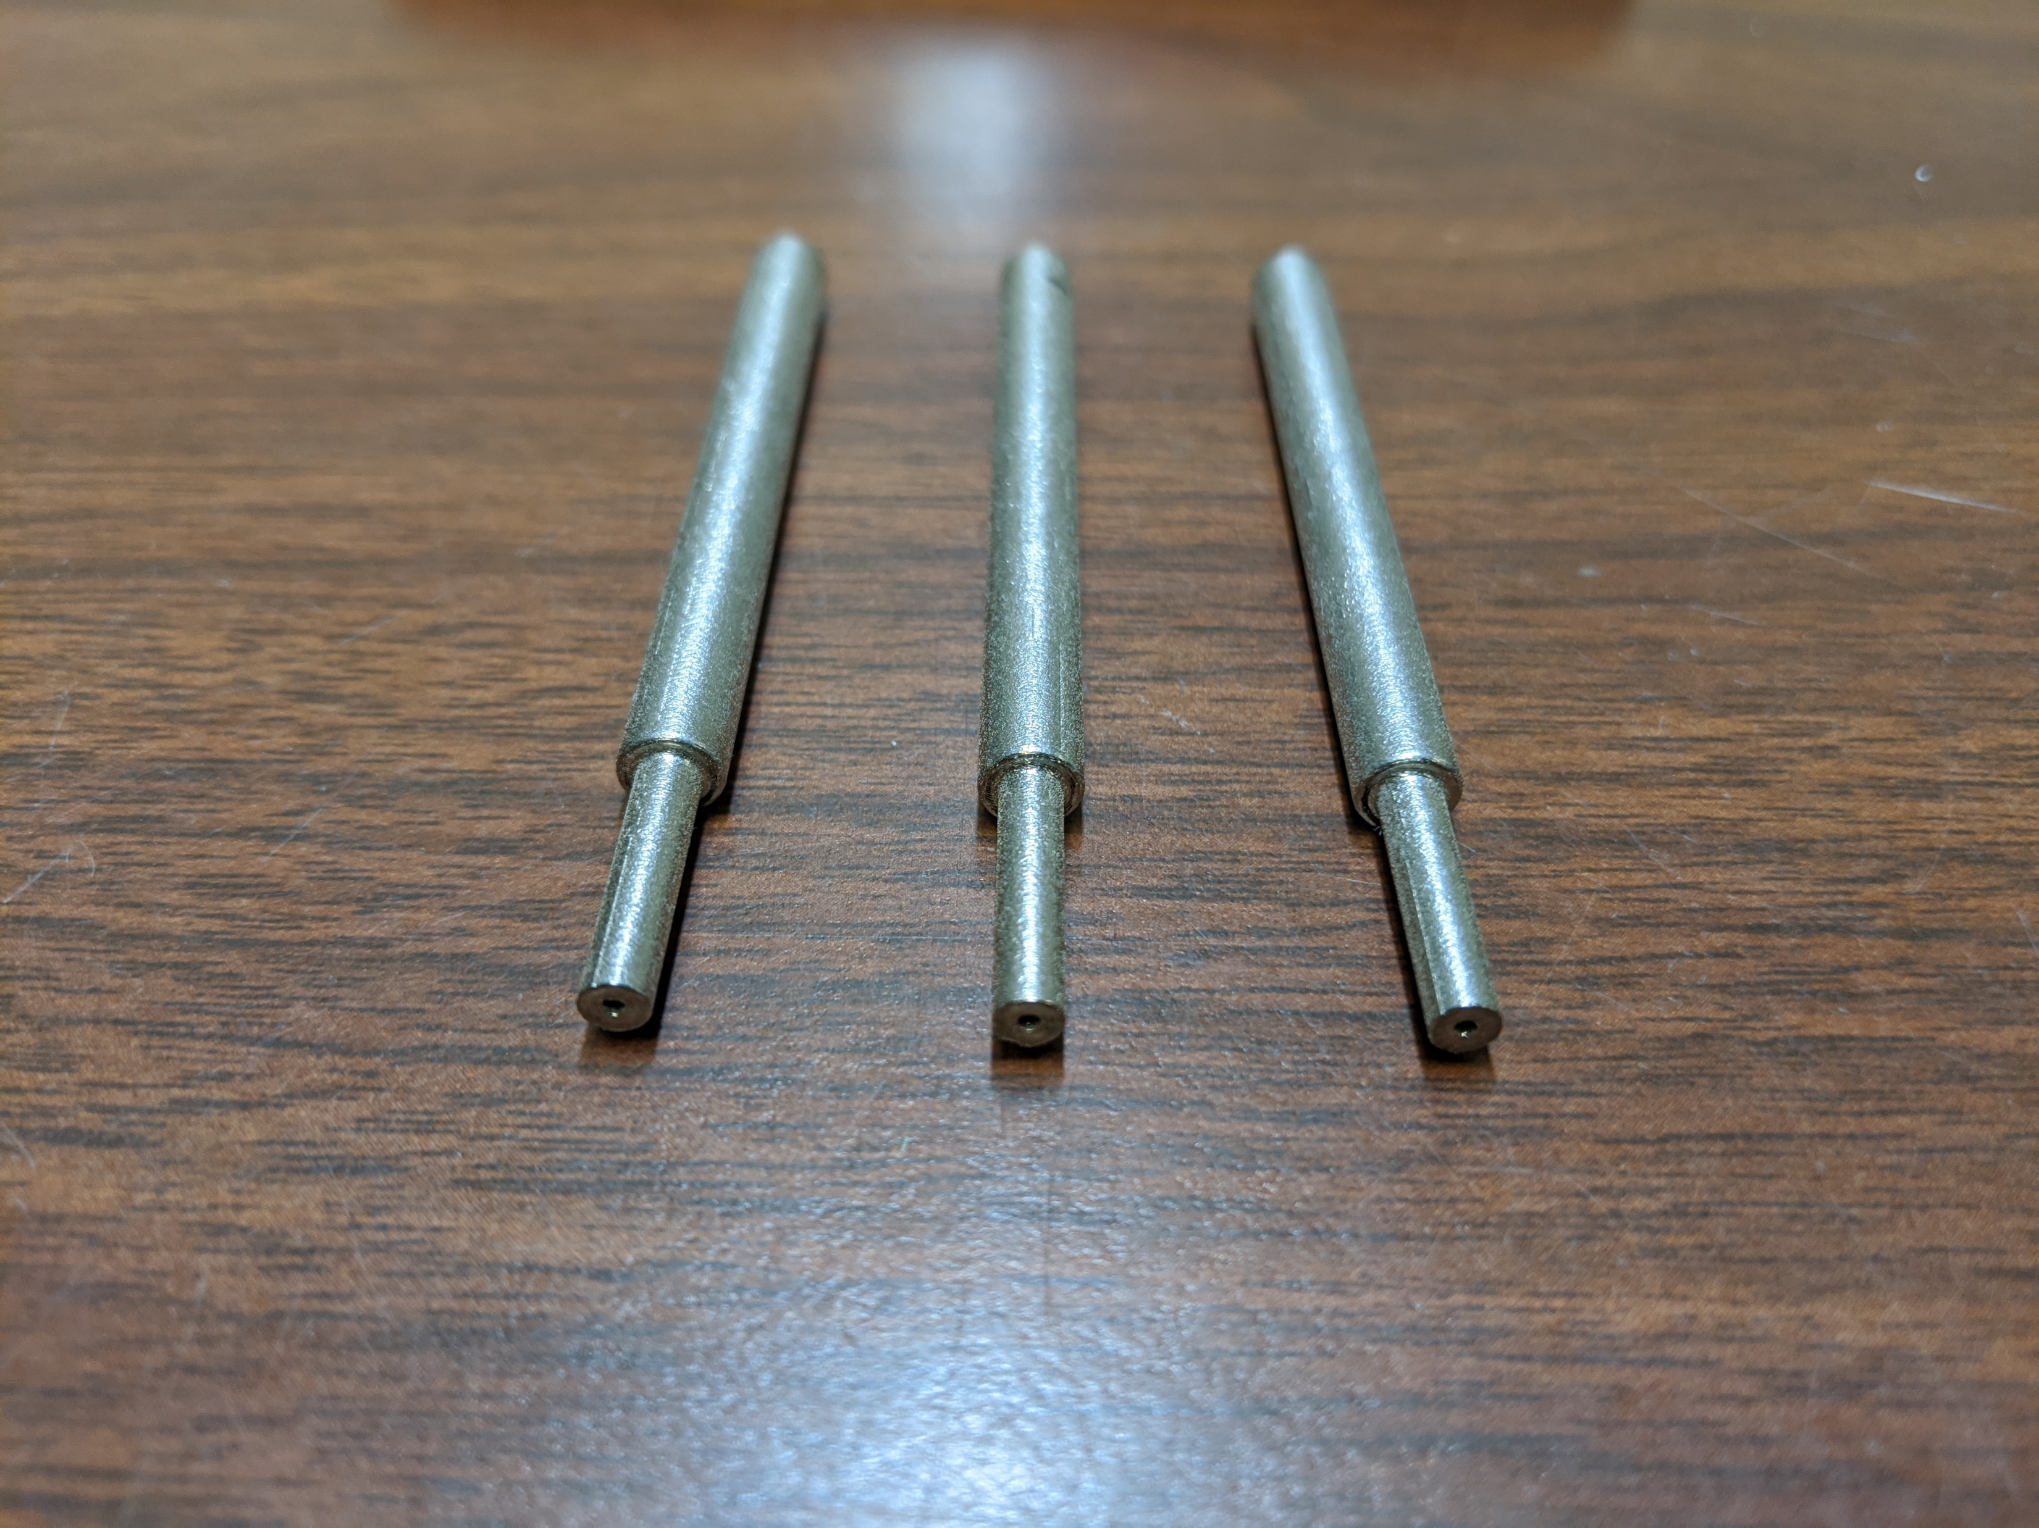
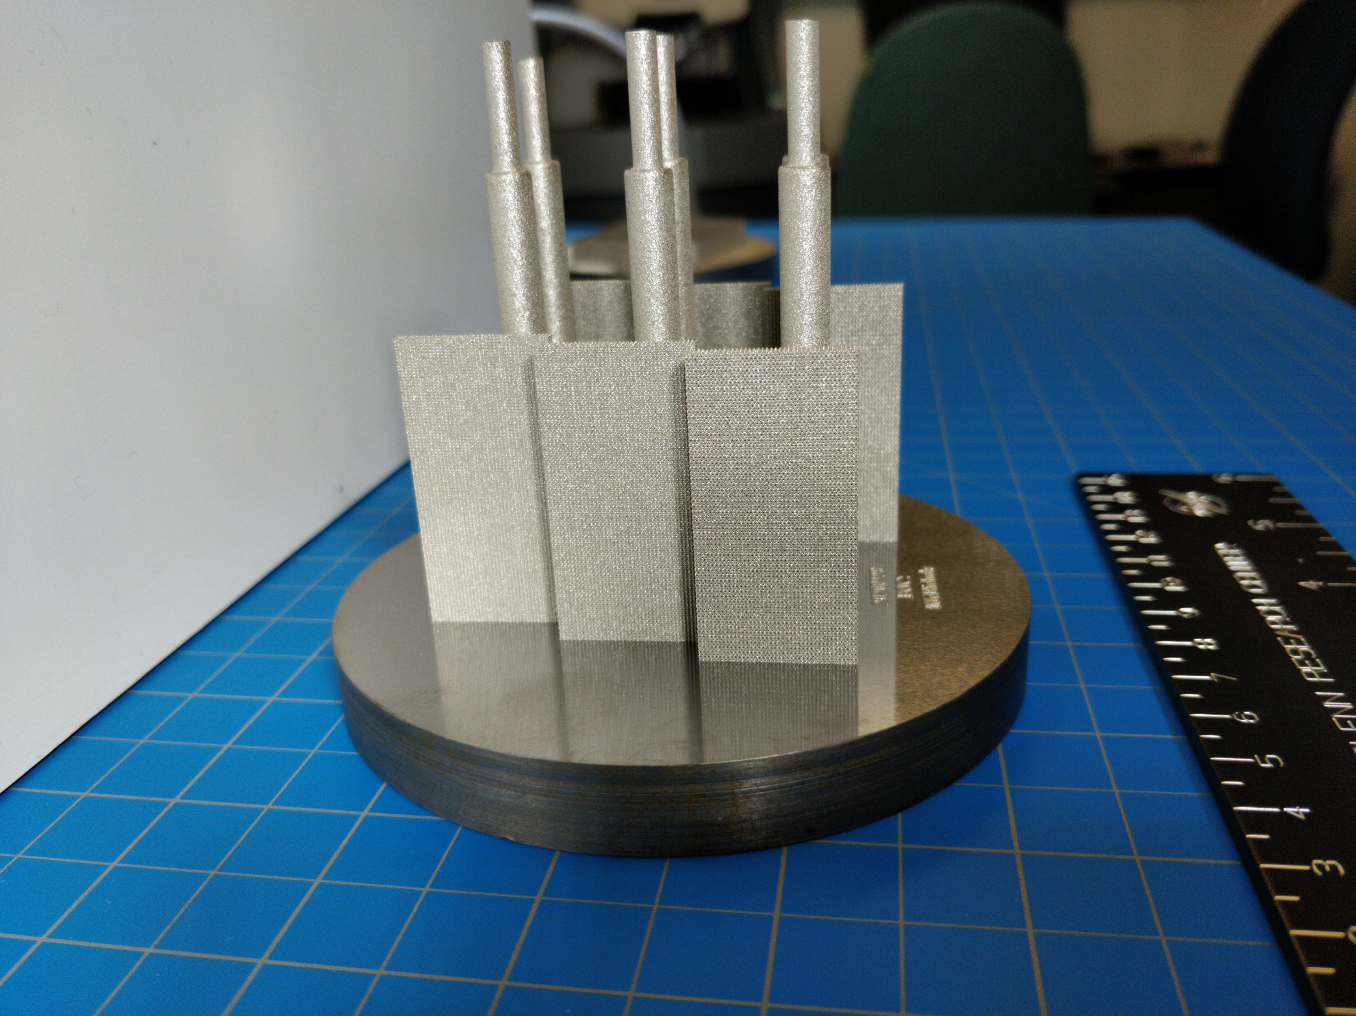
WHAT’S NEXT…
CALIBRATE EQUIPMENT AND RETEST PMC MAT’L
TEST PHP & LWHP
Validate COMSOL Model

Slide 14
Thank You. Questions?

